Slide 1
Node Lunch & Learn 1

Slide 2
Agenda
Today I’m going to
(Briefly) explain the notion of “Full Stack Development”
Talk about what Node is, where it came from, and what it’s good at
Demonstrate how to use Node for some basic scripting
Set up a simple web server using Node
If we have time, I’m also going to
Show you npm, Node’s package manager and Express, the Node web server helper framework

Slide 3

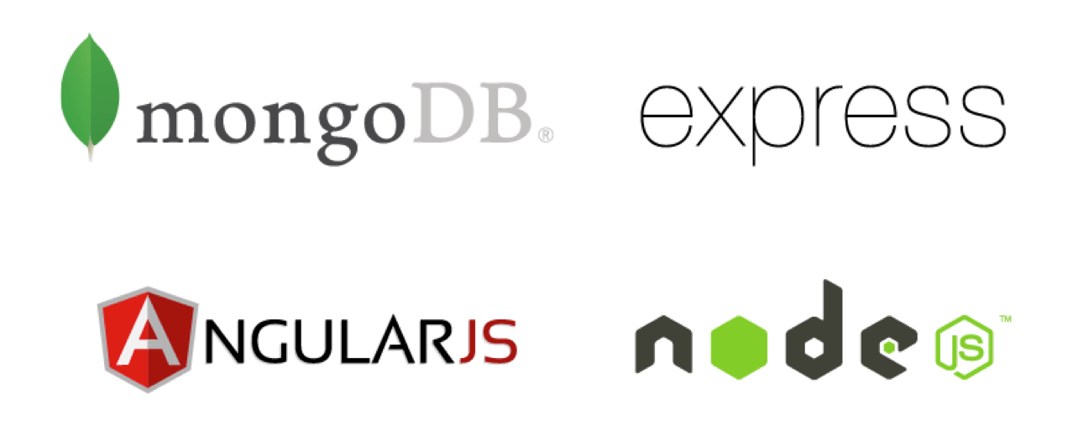
The MEAN Stack

Slide 4


The MERN Stack

Slide 5
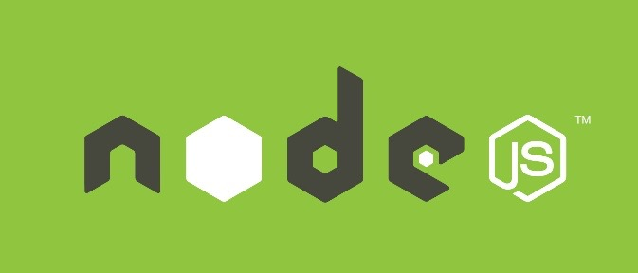
Definition of “NodeJS”
Node.js is an open-source, cross-platform JavaScript runtime environment designed to be run outside of browsers.
It is a general utility that can be used for a variety of purposes including asset compilation, scripting, monitoring, and most notably as the basis for web servers

Slide 6

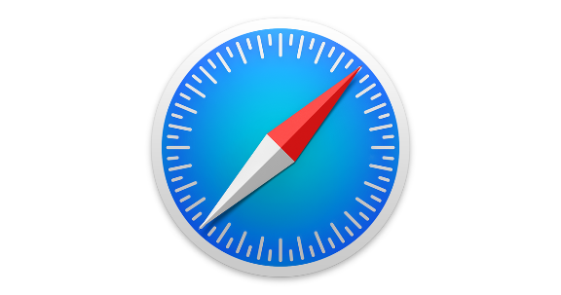



What?
Every browser has an HTML engine, a CSS engine, and a JavaScript engine
Different browsers will generally use different engines (e.g. IE and Edge use the “Chakra” JS engine while FireFox uses the “SpiderMonkey” engine
Chrome (and Opera) use Google’s “V8” engine for JavaScript

Slide 7
V8 to Node
In 2009, the creator of Node
Took the (open-source) Google V8 JS engine
Wrapped it in a C++ executable
Released it

Slide 8
Why Use NodeJS as a Server?
It re-uses Javascript – meaning a front-end Javascript developer can also build an entire server themselves
It’s easily extendable. Numerous plugins exist to expand the capabilities of Node
Fast-implementation, which allows for the creation of an entire working server with only a few lines of code.
Single-Threaded Asynchronous Model – meaning it can handle multiple requests simultaneously and not get bottlenecked.

Slide 9
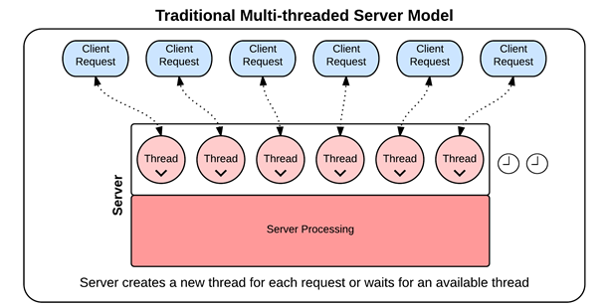
Syncrononous Threading
In traditional synchronous threading, each request requires its own thread. No other request can pass through that thread until complete. Since there is a limited pool of threads, this can create bottlenecks.

Slide 10
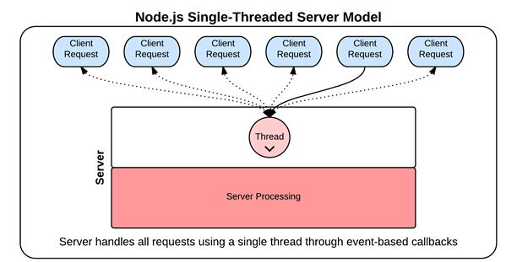
Asynchronous Threading (Node Way)

Slide 11
What is it Good For?
Feel free to use Node for
Shell scripting – Node can be used to run command-line scripts written in JavaScript
Web Servering – Node is a great web server, particularly for “Microservice” type environments.
Any “ask and wait” tasks – database calls, API calls

Slide 12
What is it Not Good For?
Avoid using Node for
CPU-intensive things – Math-intensive things, graphics-heavy stuff where the CPU is expected to do a lot

